Slide 1


Consumer Goods Ad_Hoc Insights

Slide 2
OBJECTIVES
Help the management team gain valuable insights into Atliq Hardware’s business.
Support data-driven decision-making to improve operations
DATASET
Fact Tables: Sales Monthly
Manufacturing Cost
Pre-Invoice Deductions
Gross Price
Dimension Tables: Customer Details
Product Details
Fiscal Year: Atliq’s fiscal year starts on 1st September and ends on 31st August each year.
Sales Data Availability: Fiscal year 2020-2021
Ad Hoc Requests & Insights
There are given 10 Ad hoc requests, Used SQL and Power BI to get the Insights.

Slide 3
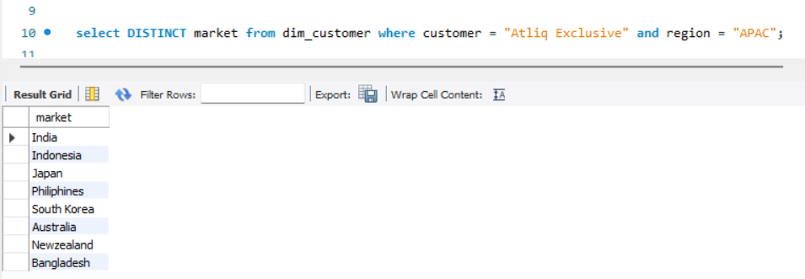
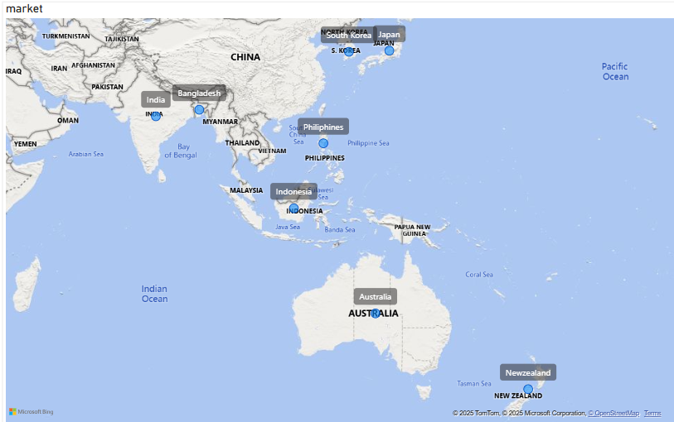
Provide the list of markets in which customer "Atliq Exclusive" operates its business in the APAC region.
Query & Output :
Insights :
Atiq Exclusive is located in 8 countries in APAC Region

Slide 4
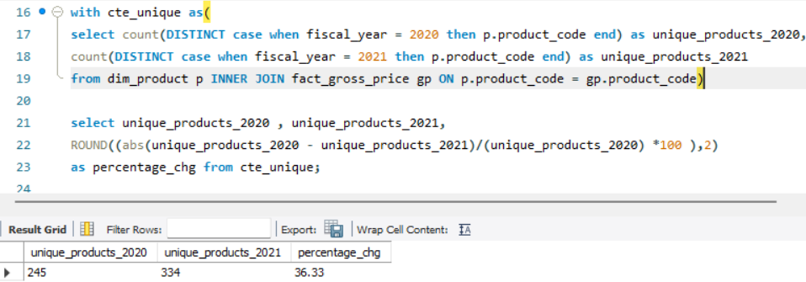
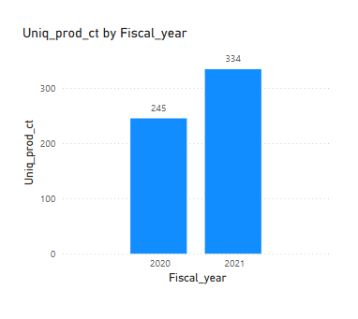
What is the percentage of unique product increase in 2021 vs. 2020? The final output contains these fields, unique_products_2020 unique_products_2021 percentage_chg
Query & Output :
Insights :
Atliq Hardware has achieved a significant 36.33% growth in new product offerings from the year 2020 to 2021, strengthening its reputation as an innovative and adaptable brand. By aligning with evolving customer needs, the company continues to drive market relevance and customer satisfaction

Slide 5
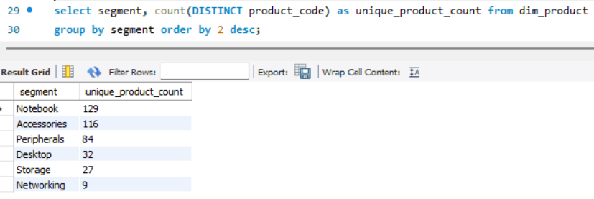
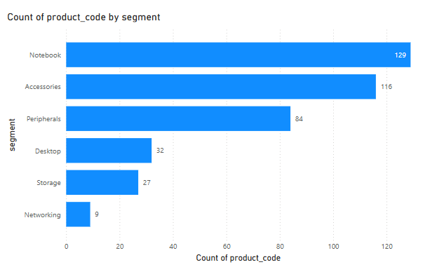
Provide a report with all the unique product counts for each segment and sort them in descending order of product counts. The final output contains 2 fields, segment product_count
Query & Output :
Insights :
Atliq Hardware's product portfolio is strongest in the Notebook (129), Accessories (116), and Peripherals (84) segments, reflecting higher market demand. In contrast, Desktop (32), Storage (27), and Networking (9) segments have fewer offerings.
The Development team should assess underperforming segments and redesign products to meet modern standards and market trends.
By focusing on innovation and expanding high-demand segments , Atliq Hardware can sustain its competitive advantage.

Slide 6
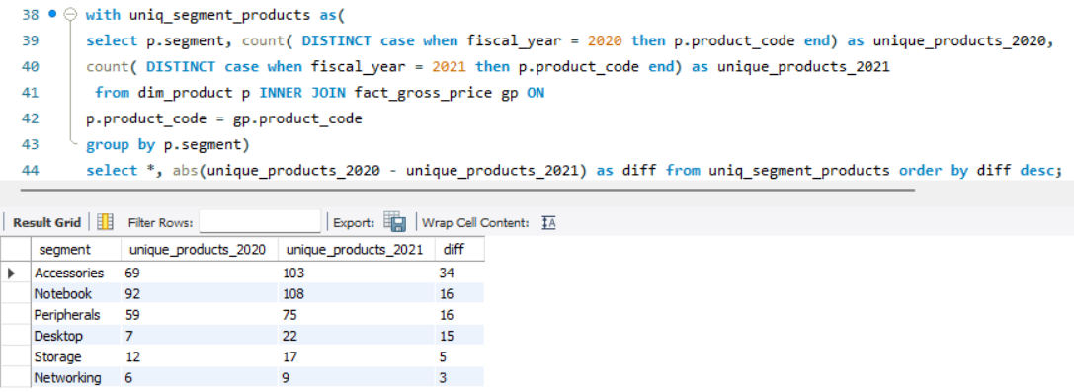
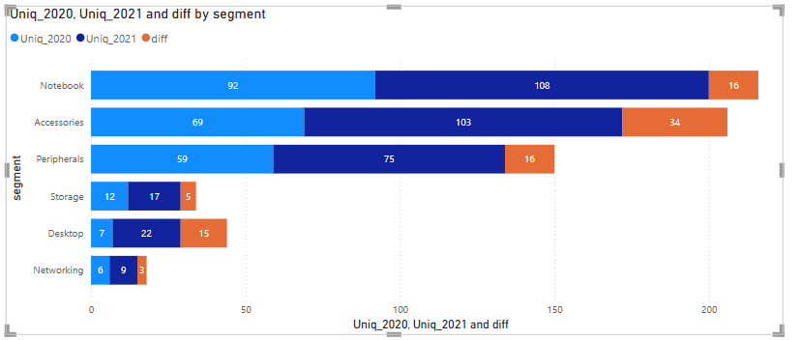
Which segment had the most increase in unique products in 2021 vs 2020? The final output contains these fields, segment product_count_2020 product_count_2021 difference
Query & Output :
Insights :
Accessories saw the highest growth with 34 new products.
Notebook and Peripherals added 16 new products each.
Desktop improved from 7 to 22 products.
Networking saw the least growth, with only 3 new products

Slide 7
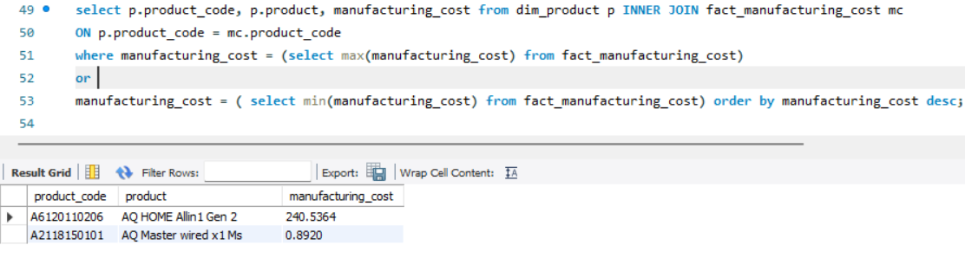
Get the products that have the highest and lowest manufacturing costs. The final output should contain these fields, product_code product manufacturing_cost
Query & Output :
Insights : AQ Home Alin 1 Gen 2 consumes high production cost of $240.54, where as AQ Master wired x1 Ms is of cheapest production cost

Slide 8
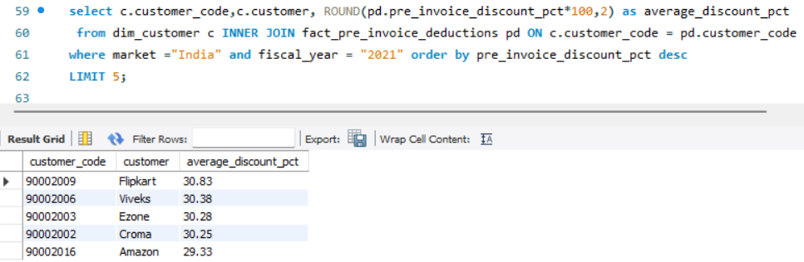
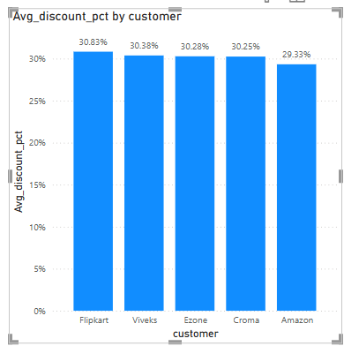
Generate a report which contains the top 5 customers who received an average high pre_invoice_discount_pct for the fiscal year 2021 and in the Indian market. The final output contains these fields, customer_code customer average_discount_percentage
Query & Output :
Insights :
Flipkart received the highest pre-invoice discount at 30.83% and Amazon is at the bottom.
Top 5 customers related to Indian Market and in Fiscal year 2021 received similar discount with an average discount of 30.21%.

Slide 9
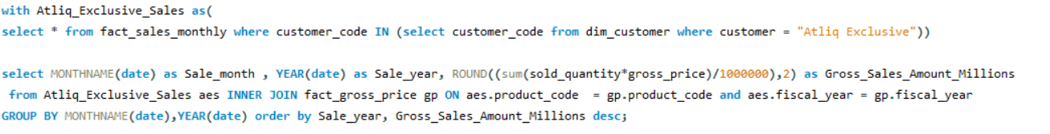
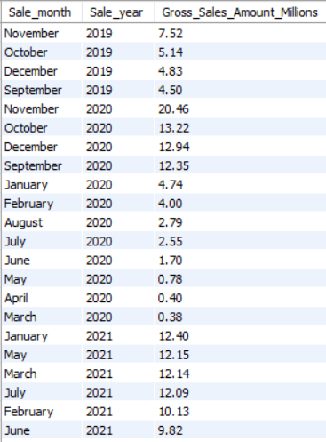
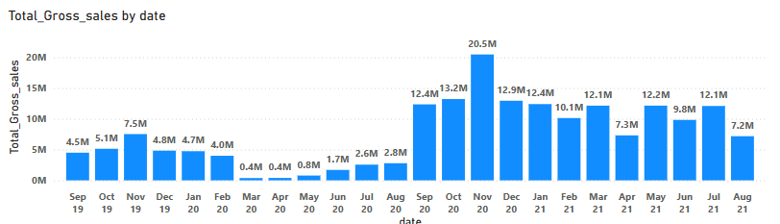
Get the complete report of the Gross sales amount for the customer “Atliq Exclusive” for each month . This analysis helps to get an idea of low and high-performing months and take strategic decisions. The final report contains these columns: Month Year Gross sales Amount
Query :
Output :
Insights :
Sales were low from March to August 2020 due to covid pandemic-related lock down
Sales improved from September 2020 onwards and had highest sales in month of November and December with lockdown easing and the Christmas and New year season.

Slide 10
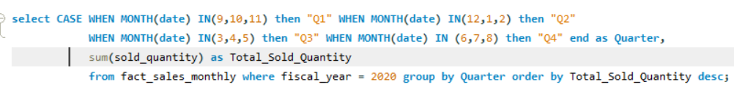
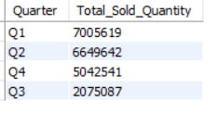
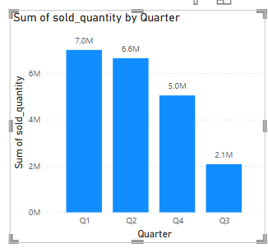
In which quarter of 2020, got the maximum total_sold_quantity? The final output contains these fields sorted by the total_sold_quantity, Quarter total_sold_quantity
Query :
Output :
Insights :
Q1 (September–November) had the highest quantity sold in Fiscal year 2020.
Sales dropped in Q3 to 2.1 Millions (March–May) and picked up in Q4 (June–August) to 5 Millions.

Slide 11
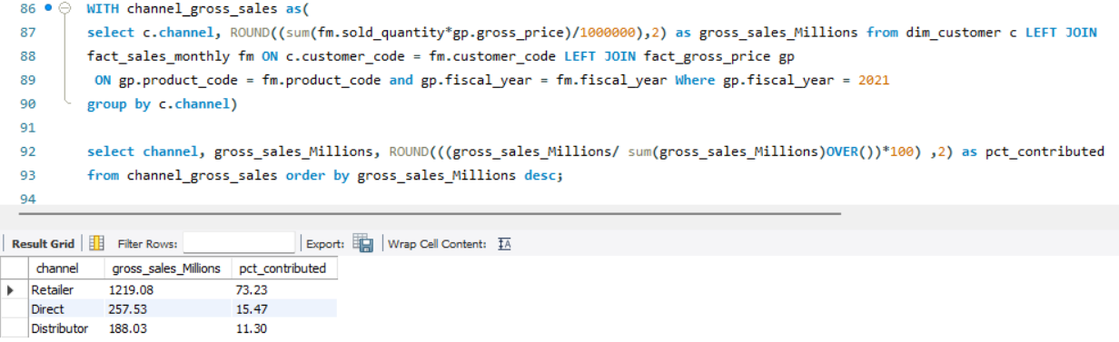
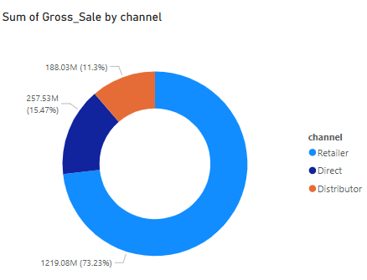
Which channel helped to bring more gross sales in the fiscal year 2021 and the percentage of contribution? The final output contains these fields, channel gross_sales_mln percentage
Query & Output:
Insights :
The Maximum share of gross sales is done through “Retailers” which is nearly 73 %
On the other hand, Direct Channel with 15.47 % and the nearly 11% sales from Distributor Channel

Slide 12
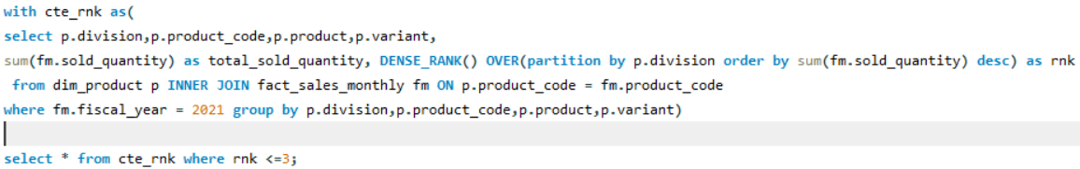
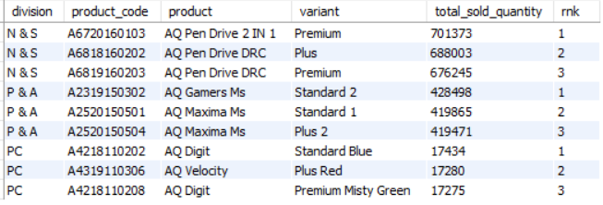
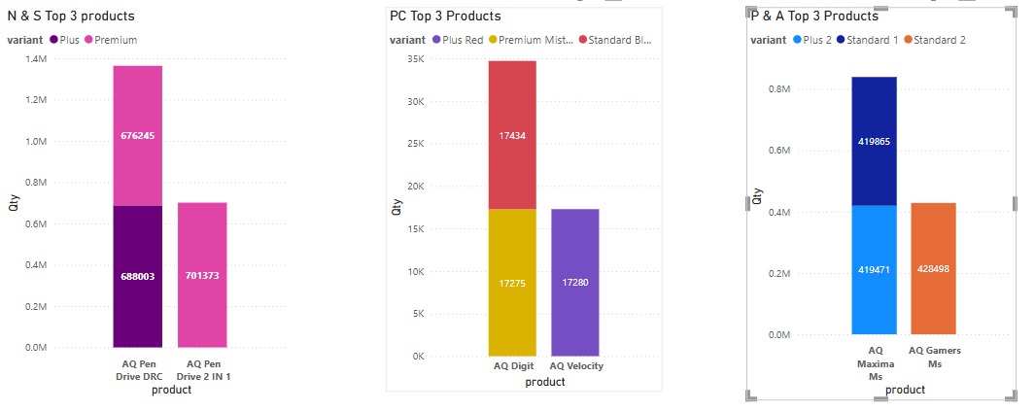
Get the Top 3 products in each division that have a high total_sold_quantity in the fiscal_year 2021? The final output contains these fields, division product_code product total_sold_quantity rank_order
Query :
Output :
Insights :
In N&S , Premium AQ Pen Drive 2 in 1 is most sold product
AQ Velocity with Plus Red variant has highest sales in PC section
Standard2 AQ Gamers Ms is highest selling product in P&A
Across all these three divisions, the stocks of these products should be kept high as these are in high demand to get good sales

